Slide 1
Sensitivity to moral goodness under different aesthetic contexts
Chenjing Wu, Hongyan Zhu, Yameng Zhang, Wei Zhang & Xianyou He (2023) Sensitivity to moral goodness under different aesthetic contexts, Ethics & Behavior, DOI: 10.1080/10508422.2023.2209230
报告人：韩佳豪

Slide 2
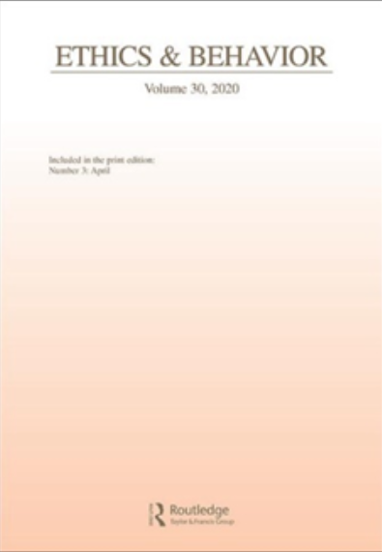
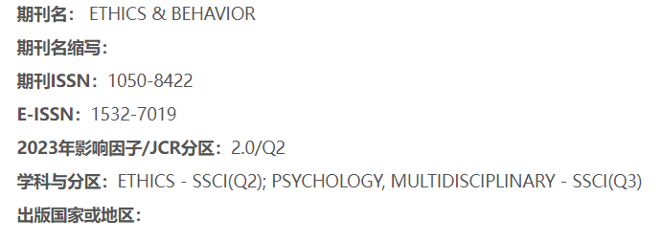

Slide 3
En somme, la Beauté est partout. Ce n’est point elle qui manque à nos yeux, mais nos yeux qui manquent à l’apercevoir.
–Auguste Rodin

Slide 4
理论背景
THEORY

Slide 5
01
PART
引言——理论背景
INTRODUCTION
Moral sensitivity 道德敏感性是个体感知情境的道德本质和意识到事件后果的能力。(Rest, 1984).
Scenes generally consist of a context and foreground objects, and individuals gradually accumulate knowledge of scenes in their lives (场景图式).Object recognition is influenced by contextual information .(Bublatzky et al., 2020; Droll & Eckstein, 2008; Eckstein et al., 2006; Oliva & Torralba, 2007; Romero-Ferreiro et al., 2018). The finding also is found in moral sensibility.
Zheng and Cen (2007) discovered that an individual’s moral sensitivity is influenced by the clarity of contextual information and that it decreases when faced with increasing moral ambiguity（模糊性）.

Slide 6
01
PART
引言-问题假设
INTRODUCTION
Davenport and Potter (2004) investigated the influence of consistent and inconsistent relations between objects and contexts and found that when stimuli and contexts were consistent, object recognition was more accurate than when they were inconsistent(情景一致提高认知精确性).
Therefore, we hypothesized that context can assist indetecting moral behaviors in daily life. The sensitivity to moral goodness can also be influenced by contextual information.(上下文信息可以影响道德敏感性).
.
we hypothesized that an individual’s sensitivity to moral behavior would be heightened in an aesthetic context. Contexts with high aesthetic value would make people more sensitive to moral behavior (a higher rate of recognition and shorter recognition time) than contexts with low aesthetic value.(更高的审美语境带来更高的道德敏感判断).
This study explored the effect of contextual aesthetic information on moral sensitivity to determine the role of contextual information in finding inner beauty (moral goodness). Using eye-movement techniques, we confirmed the consistency between contextual aesthetic information and morality.(利用眼动技术判断一致性和反应时间的关系)

Slide 7
方法 实验Ⅰ
METHOD

Slide 8
02
PART
方法-参与者与程序
METHOD
Experiment 1 involved a 2 (types of contextual aesthetic value: high vs. low) × 2 (types of behavioral scene drawings: moral vs. immoral) within-subject experimental design. Participants were instructed to identify the moral information of an behavior based on the context of its aesthetic value. The dependent variables were the reaction time and the correct accuracy rate (ACC).
Participants were 32 college students between the ages 18–30 years (M = 21.6; SD = 0.98). Seventeen participants were identified as female and 15 as male. Using G* Power 3.1, this sample size resulted in an estimated power of (1-β = 0.92) with an effect size (d = 0.26).

Slide 9
02
PART
方法-实验材料
METHOD
A total of 34 color images with high aesthetic contexts and 34 color photographs with low aesthetic, social, and natural contexts ere selected from a public archive (http://baidu. com).
A separate group of 13 individuals (5 males, M = 25.23 years, SD = 4.78) judged the aesthetics of the contextual materials on a 7-point scale. The aesthetic assessments of surrounding images were significantly different across the two sets of items: t(12) = −11.65, p < .05, 95% CI[−3.24, −2.22], Cohen’s d = −3.25 (aesthetic rating for the high aesthetic context, 5.11 ± 0.58; aesthetic rating for the low aesthetic context, 2.39 ± 0.84). （七点平均法）

Slide 10
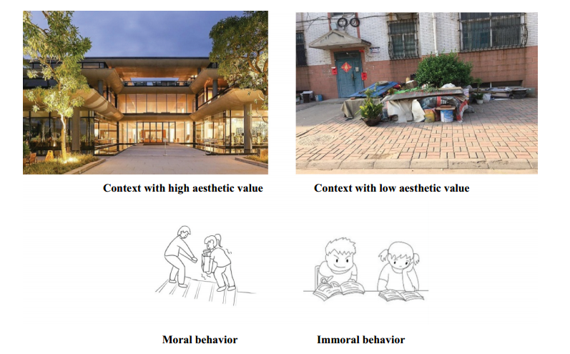

Slide 11
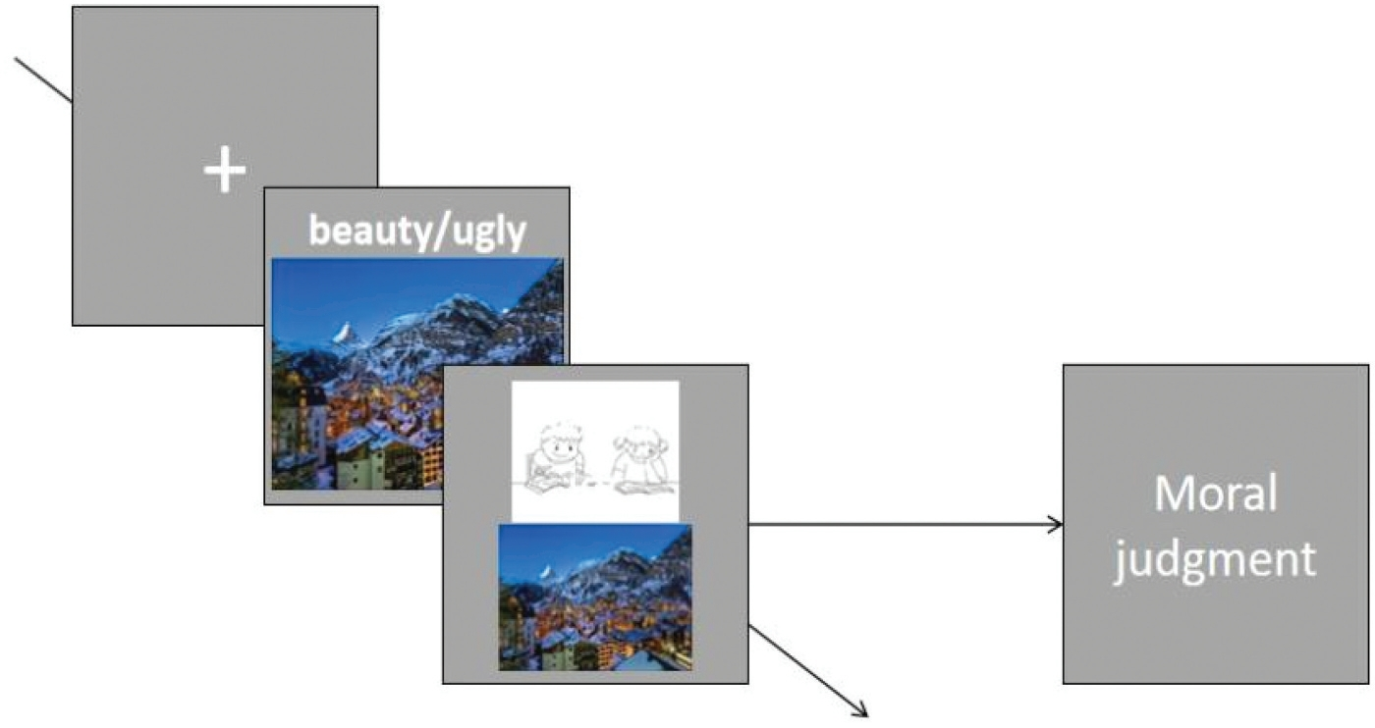

Slide 12
结果 实验Ⅰa
RESULTS

Slide 13
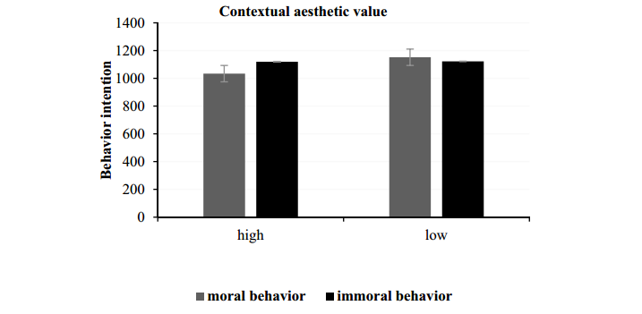

Slide 14
03
PART
结果-事后分析
A 2 (types of contextual aesthetic value: high vs. low) × 2 (types of behavioral scene drawings: moral vs. immoral behavior) repeated-measures analysis of variance (ANOVA) was performed on the reaction times of participants.
Table 1 illustrates the mean scores of the reaction time and the ACC in various contexts. According to the ACC findings, the main effect of the contextual aesthetic value type was not significant, F (1, 31) = 1.60, p = .22. The main effect of the behavioral scene drawing type was not significant, with F (1, 31) = 1.88, p = .18 (Table 1). The interaction effect between contextual aesthetic value types and behavioral scene drawing types was likewise not significant, with F (1, 31) = 2.56, p = .12.（精准度不显著）
The results demonstrated that the main effect of contextual aesthetic value kinds on reaction time was insignificant, The main effect of the behavioral scene drawing type was significant .The interaction effect between types of contextual aesthetic value and types of behavioral scene drawings was also significant .The reaction time for moral behavior was somewhat faster in contexts with high aesthetic values than in contexts with low aesthetic values, with t (31) = −3.55, p = .001, 95% CI [−185.54, −50.05], and Cohen’s d= −0.63. significantly across high and low aesthetic contexts, t (31) = −The reaction time for immoral behavior did not differ 0.17, and p = .87.
RESULTS

Slide 15
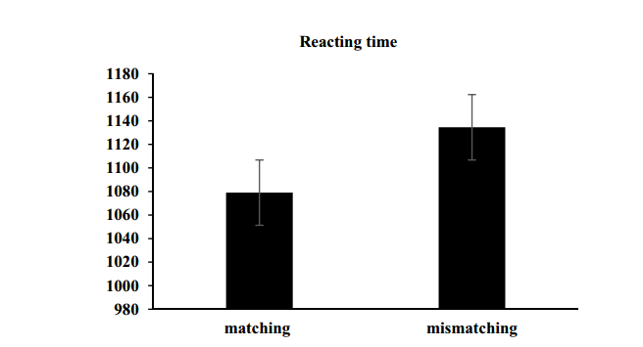

Slide 16
03
PART
结果-事后分析
RESULTS
Match (high aesthetic context/moral behavior and low aesthetic context/immoral behavior), as well as relations that did not match (high aesthetic context/ immoral behavior and low aesthetic context/moral behavior).
the mismatch condition had significantly higher reaction times than those in the matching condition, t (31) = −3.39, p = .002, 95% CI [−88.96, −22.12], and Cohen’s d = −0.56. This research also demonstrated that the ACC of individuals in various contexts was not distinct, t (31) = 1.60, p = .12, 95% CI [−0.20, 1.64] (Table 2 and Figure 4).
Experiment 1, we did not find a difference between high and low aesthetic contexts for immoral behavior in terms of reaction time. It could be due to the fact that the depictions of moral and immoral behaviors were unambiguous（过于清楚的）, allowing participants to rapidly identify their morality. In Experiment 1b, we employed ambiguous images of behaviors experimental material to limit the influence of this variable and better examine the relation between contextual aesthetic value and sensitivity to moral goodness.

Slide 17
方法 实验Ⅰb
METHOD

Slide 18
04
PART
方法-参与者与程序
METHOD
Experiment 1 involved a 2 (types of contextual aesthetic value: high vs. low) × 2 (types of behavioral scene drawings: moral vs. immoral) within-subject experimental design. Participants were instructed to identify the moral information of an behavior based on the context of its aesthetic value. The dependent variables were the reaction time and the correct accuracy rate (ACC).
Participants were 32 college students between the ages 18–30 years (M = 21.6; SD = 0.98). Seventeen participants were identified as female and 15 as male. Using G* Power 3.1, this sample size resulted in an estimated power of (1-β = 0.92) with an effect size (d = 0.26).

Slide 19
04
PART
方法-参与者与程序
METHOD
Twelve university students (4 males, 26.33 ± 4.27 years old) were re-recruited for Experiment 1b to evaluate the semantic ambiguity of the ambiguous material on a 7-point scale, with 1 representing very ambiguous and 7 representing very clear, and larger numbers showing a clearer meaning of the picture. It was determined that semantic ambiguity did not differ significantly between the two groups of material, [t(11) = 1.70, p > .05; moral behavior: 3.30 ± 1.42, immoral behavior: 3.08 ± 1.54], indicating that the semantic ambiguity of the images was at a moderate level.
A fixation target was initially presented for 500 ms, followed by a merged image of the context and a ambiguous behavior. All the images appeared arbitrarily. The participant was required to swiftly determine whether the ambiguous behavioral image was moral (“F” key) or immoral (“J” key)

Slide 20
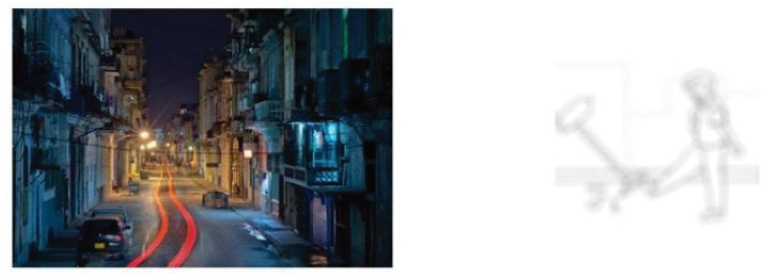

Slide 21
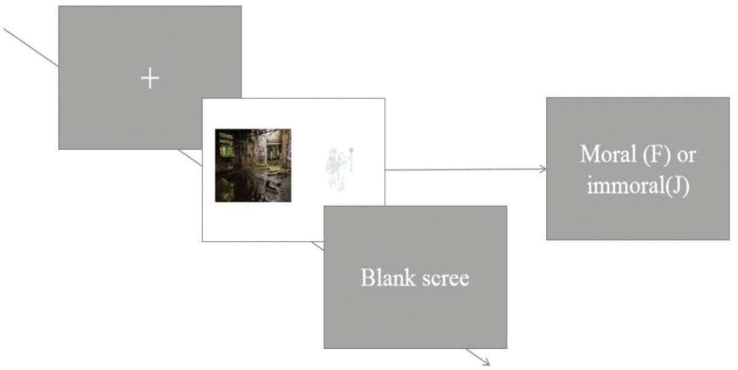

Slide 22
结果 实验 Ⅰb
RESULTS

Slide 23
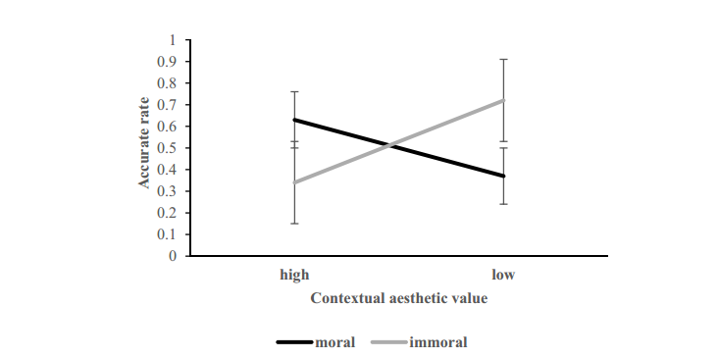

Slide 24
05
PART
结果-事后分析
RESULTS
Moral behavior vs. immoral behavior repeated-measures analysis of variance (ANOVA) was performed for the ACC and reaction time.
The results demonstrated that the main effect of the contextual aesthetic value type was significant, F(1, 68) = 18.39, p < .001, and η2 = 0.20. The main effect of the behavioral scene drawing type was insignificant, F(1, 68) = 2.92, p = .092, and η2 = 0.041 (Table 3). Interaction effect between types of contextual aesthetic value and types of behavioral scene drawings produced a substantial interaction effect, with F(1, 68) = 33.65, p < .001, and η2 = 0.33
In high aesthetic contexts, the ACC for moral behavior was greater than in low aesthetic contexts, with t (68) = 5.15, p < .001, 95% CI [0.17, 0.38], and Cohen’s d= 0.62. The ACC for immoral behavior was significantly different across high- and low-aesthetic contexts, t (68) = −6.11, p < .001, 95% CI [−0.52, −0.26], and Cohen’s d = −0.74.

Slide 25
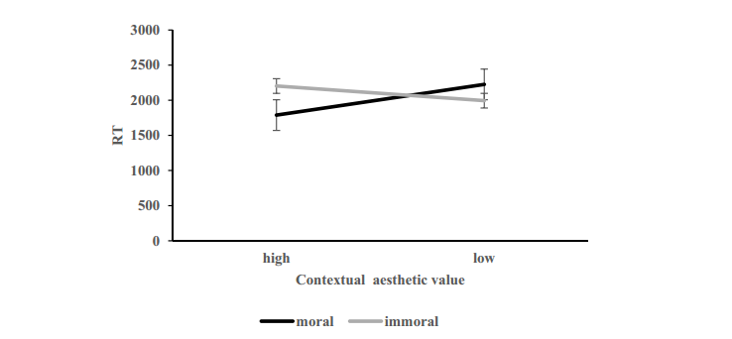

Slide 26
05
PART
结果-事后分析
RESULTS
A high aesthetic context was associated with a slightly shorter mean reaction time for moral behavior than a low aesthetic context.
In terms of the accuracy rate, the matching relation performed better than the mismatching relation, t (68) = 5.84, p < .001, 95% CI [0.21, 0.44], and Cohen’s d = 0.69. Individuals in the mismatching relation demonstrated considerably slower reaction times than those in the matching condition, t (37) = −2.32, p = .026, 95% CI [−605.20, −40.66], and Cohen’s d = −0.38 (Table 5).

Slide 27
讨论—实验Ⅰ
DISCUSSION

Slide 28
06
PART
讨论——实验Ⅰ
DISCUSSION
（1) individuals are more sensitive to moral behaviors in contexts with high aesthetic value.
(2) We attribute（归因） the influence of contextual information on sensitivity to moral goodness to similarities between contextual information and morality.
(3) In Experiment 2, we used eye movements to demonstrate whether contextual aesthetic value and morality have a matching relation

Slide 29
方法 实验Ⅱ
METHOD

Slide 30
06
PART
方法——参与者与程序
METHOD
材料同实验Ⅰa.
The dependent variables were the participants’ fixation counts and times while viewing the various types of images.
They observed scene images using binocular vision.however, only the right eye was tracked.

Slide 31
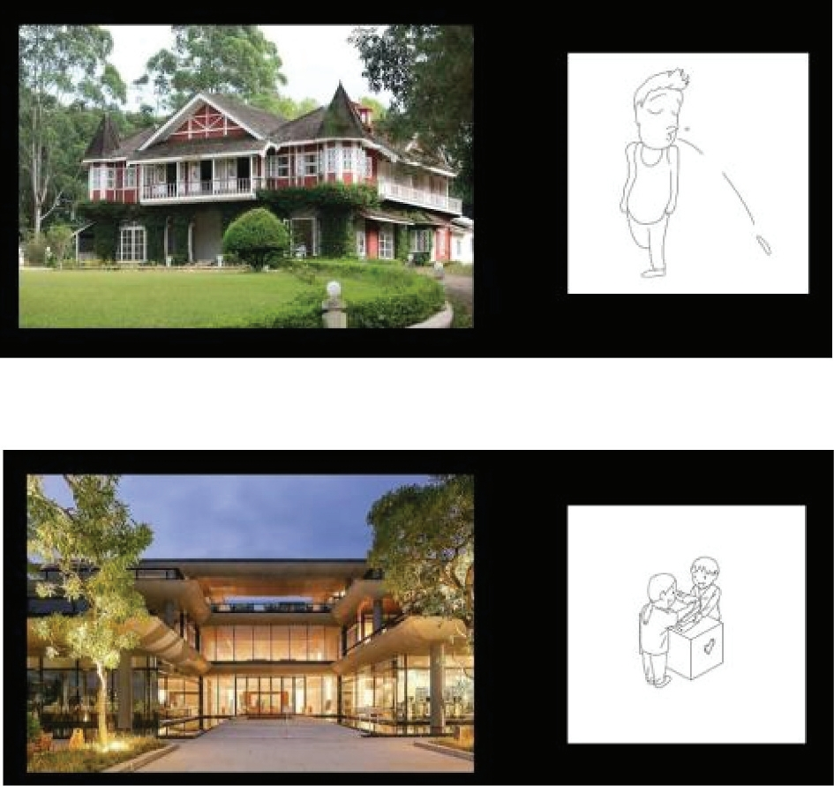

Slide 32
结果 实验二
RESULTS

Slide 33
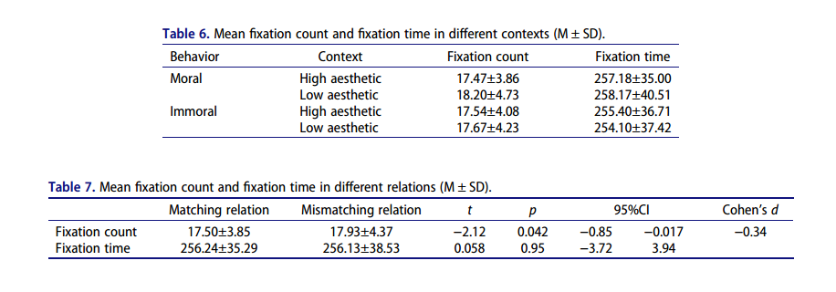

Slide 34
07
PART
结果-事后分析
RESULTS
The findings revealed that the main effect of contextual type on fixation count for the moral behavior was statistically significant. Furthermore, the result indicated that the main effect of contextual type on fixation count was insignificant when confronted with immoral behavior(p = .66).（注视次数显著）
The findings demonstrated that the main effect of contextual type on fixation time when confronting moral behavior was not significant and the main effect of contextual type on fixation time in the presence of immoral behavior was not significant,（注视时间不显著）
In addition, the main effect of relation type on fixation time was statistically significant (p < .05), and for fixation count was insignificant (p > .05) .（类型匹配在时间上显著次数上不显著）

Slide 35
Statistical analysis of the fixation count revealed a significant difference between the matching and mismatching relations (p < .05), whereas there was no difference between the matching and mismatching relations fixation time.(与上一句相反？)
As a result, we hypothesized a correlation between a high aesthetic context and moral behavior and a low aesthetic context and immoral behavior.（具有一致性）

Slide 36
总讨论
DISCUSSION

Slide 37
08
PART
总讨论——发现
DISCUSSION
We investigated sensitivity to moral goodness in various context in Experiment 1, and the results demonstrated a shorter reaction time for moral behavior in a high-aesthetic context and for immoral behavior in a low-aesthetic context.（一致情况反应更快）
The Experiment 2 examined the correlation between contextual aesthetic value and morality. The matching condition (high aesthetic context and moral behavior) was associated with a lower fixation time and count than was the mismatching condition (low aesthetic value context and moral behavior). （相关）

Slide 38
08
PART
总讨论——展望
DISCUSSION
Future studies can employ EEG to determine whether there are changes in p300 when different behaviors arise in contexts with different aesthetic values, as well as the link between the size of these waves and behavior, providing brain-neural evidence for the matching relation. There is no dearth of beauty in life; rather, there is an absence of perceptive eyes.
Since both the medial orbitofrontal cortex and the insular cortex are emotion-regulating brain regions, we hypothesized that the high aesthetic context and hypersensitivity to immoral behavior may be a result of the cognitive load resulting from the emotional mismatch triggered by aesthetics and morality.

